Slide 1
MY SQL PRESENTATION
SQL
Queries on
"World Database"

Slide 2
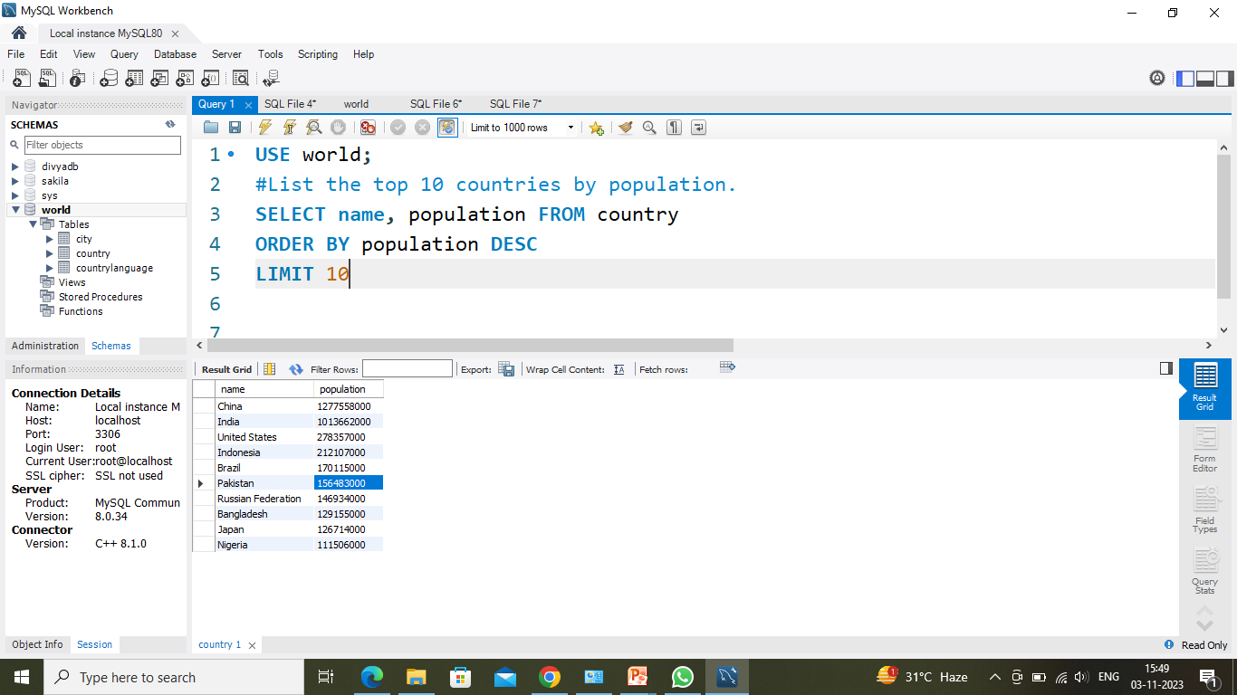
List the top 10 countries by Population
In This SQL query :
It selects the name and population of 10 most populous countries as mentioned in the given database named "world".
Then it assumes the existence of a table named "country" containing columns "NAME" & "POUPULATION".
The final result is ordered by
population in descending order with LIMIT 10.
Notes:
Rhifdf look

Slide 3
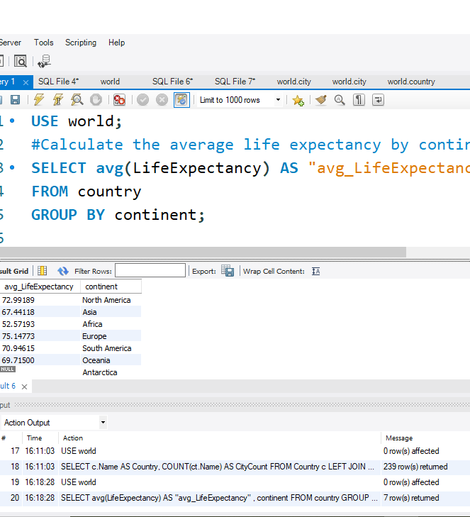
Calculate the average life expectancy by continent
In this SQL query :
It selects the average life expectancy of countries from "world" database.
"World" database contains table named "country" which contains columns named "LIFE_EXPECTANCY" & "COUNTRY".
The final results then grouped by "continent", which then provides the AVG(LIFE_EXPECTANCY) of people by "continent".

Slide 4
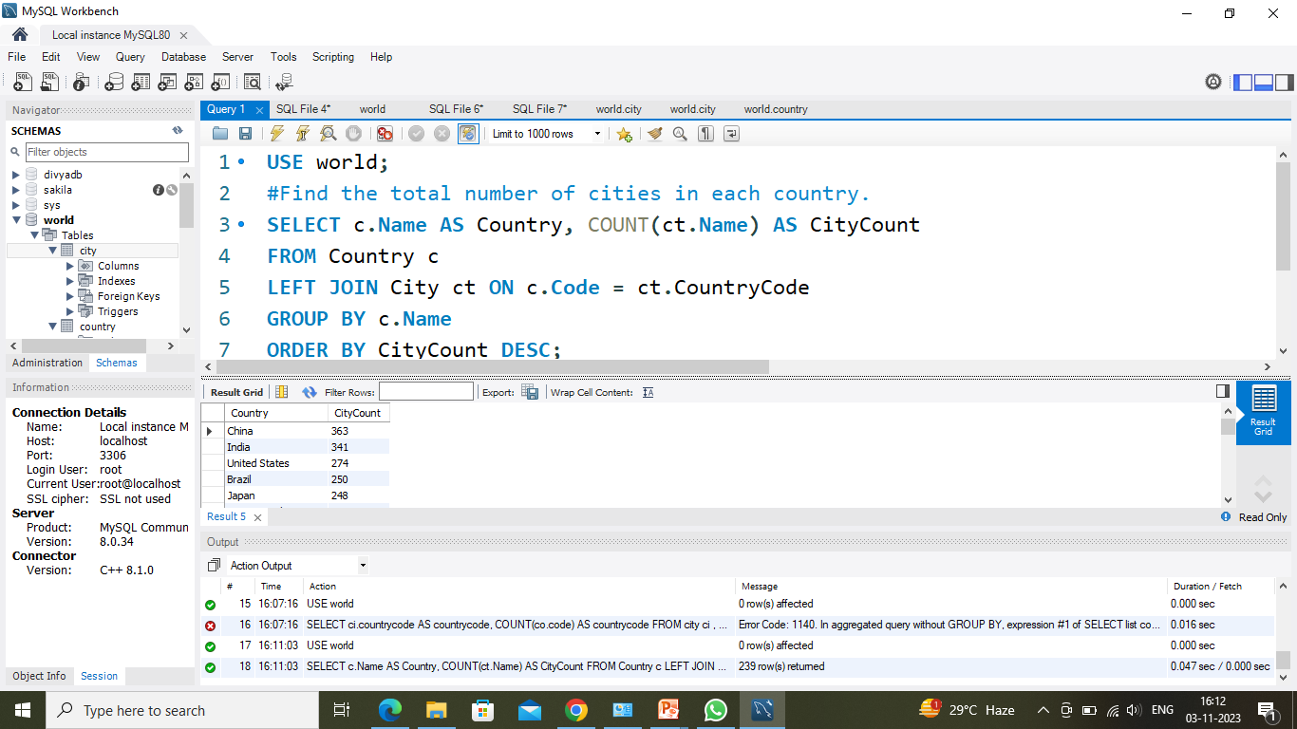
In this SQL query : It selects name from country column and name from city column as well. It then put COUNT on city's name column as city count. Then it uses LEFT JOIN to join names on city column to the names on country columns. For the resultant it group by names of country columns, then order by CITY_COUNT as descending order.
Find the total number of cities in each country ?

Slide 5
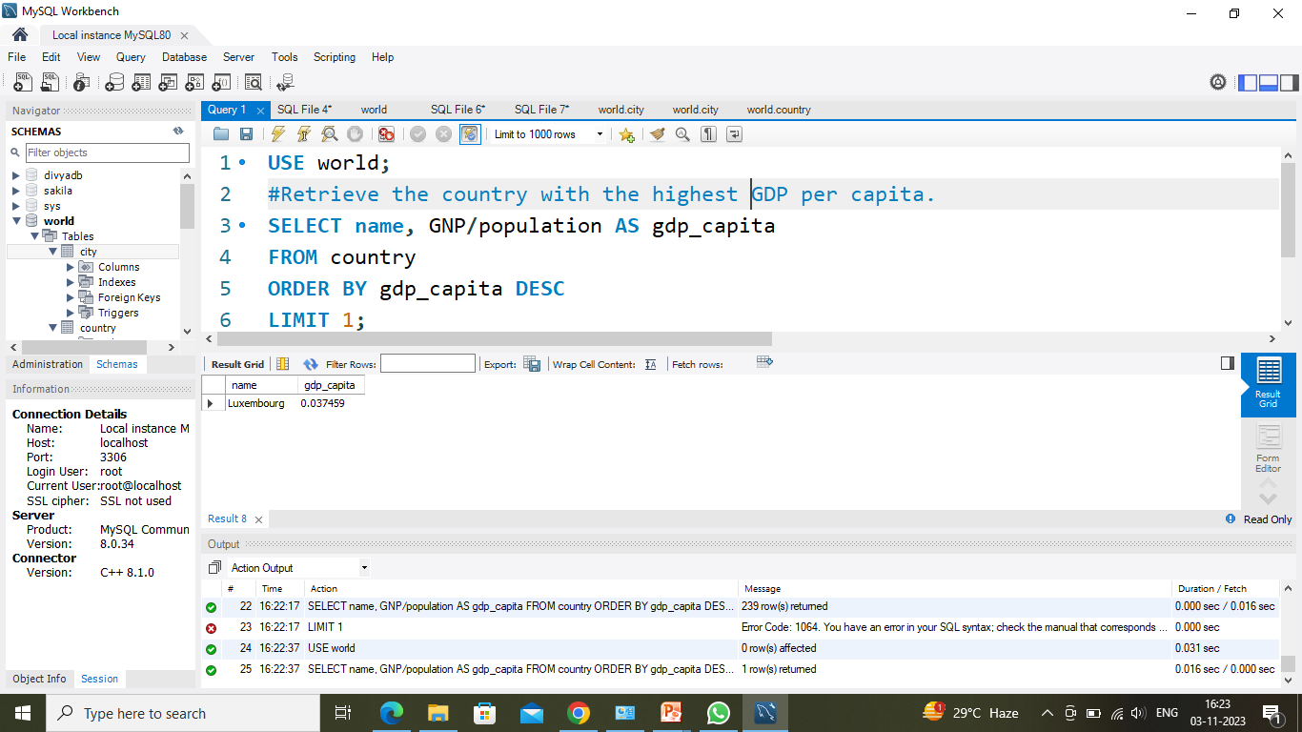
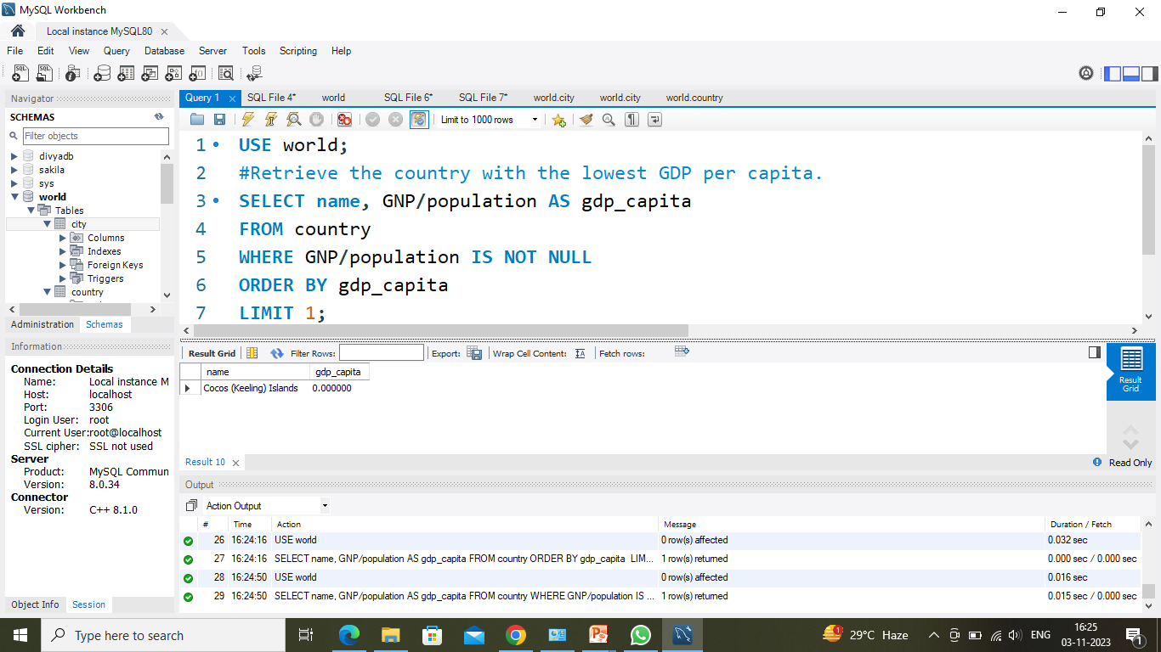
Retrieve the countries with the highest and lowest GDP per capita
HIGHEST
LOWEST

Slide 6
Lowest GDP per capita
In this SQL query :
In "World" database it selects table named "country" which contains columns such as "NAME" , "GNP" & "POPULATION".
The query calculates GDP per capita and selects the country with lowest non- null value.

Slide 7
Highest GDP per capita
In this SQL query :
In "World" database it selects table named "country" which contains columns such as "NAME" , "GNP" & "POPULATION".
The query calculates and compare GDP per capita, it then provides the result in descending order with LIMIT 1.

Slide 8
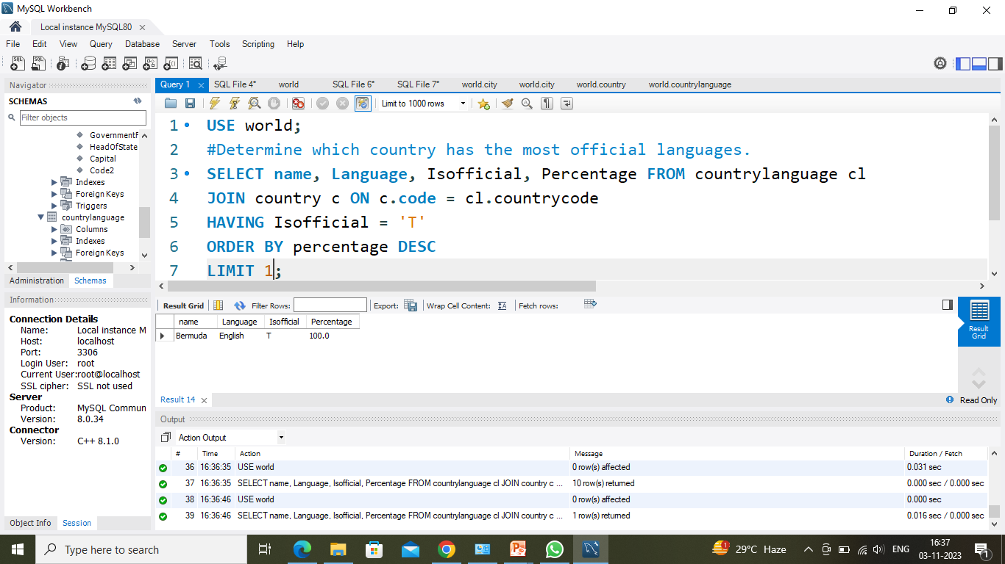
Calculate which country has the most official language
IN this SQL query :
In "World" database it has a table named "country" whose columns are "NAME", "LANGUAGE", "ISOFFICIAL", & "PERCENTAGE".
The query performs an inner join between the "country" & the "country language" tables.
Its selects the name, %age, isofficial, language from the country with the highest percentage of an official language.
Then resultant are ordered by percentage in descending order.

Slide 9
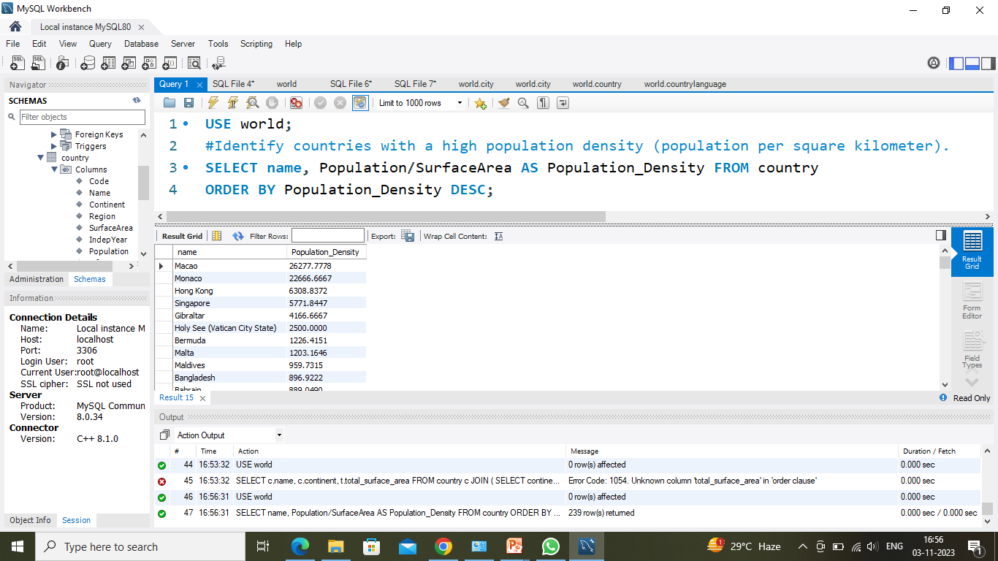
Identify countries with a high population density (population per square kilometer)
In this SQL QUERY :
In "World" database it table named country from which it selects "name", "population"& "surface area".
It calculates population density for each country and then order by it as descending order.

Slide 10
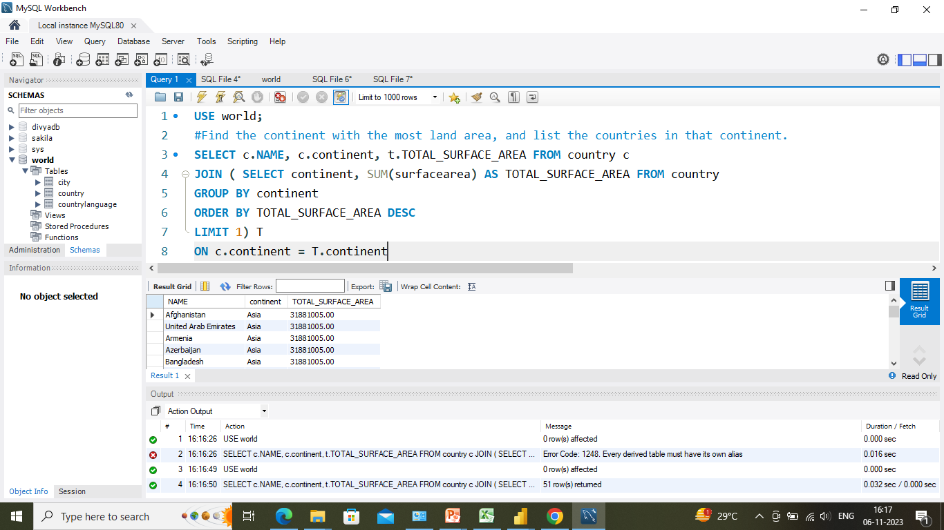
Find the continent with the most land area, and list the countries in that continent
In this SQL query :
In "World" database a table named "country" containing columns "NAME", "POPULATION" & "SURFACE AREA".
It calculates TSA for each continent.
Then identifies HIGHEST TSA and retrieve the country within the continent.

Slide 11

Regards ​
Divya Tiwari​

